Slide 1
Design & Analysis of Algorithms
Lecture 19 - Matrix Chain Multiplication

Slide 2
DP - Two key ingredients
Two key ingredients for an optimization problem to be suitable for a dynamic-programming solution:
1. optimal substructures
2. overlapping subproblems
Subproblems are dependent.
(otherwise, a divide-and-conquer approach is the choice.)
Each substructure is optimal.
(Principle of optimality)

Slide 3
Matrix-chain Multiplication
Suppose we have a sequence or chain A₁, A₂, …, A_{n} of n matrices to be multiplied
That is, we want to compute the product A₁A₂…A_{n}
There are many possible ways (parenthesizations) to compute the product

Slide 4

Matrix-chain Multiplication …contd
Example: consider the chain A₁, A₂, A₃, A₄ of 4 (i.e. n) matrices
Let us compute the product A₁A₂A₃A₄
For P(4) , you split the sequence A₁ , A₂, A₃, A₄ into:
1. Left: A₁ ; Right: A₂, A₃, A₄ → P(1) . P(3)
2. Left: A₁, A₂; Right: A₃, A₄ → P(2) . P(2)
3. Left: A₁, A₂, A₃ ; Right: A₄ → P(3) . P(1)
P(4) = P(1) . P(3) + P(2) . P(2) + P(3) . P(1)
With P(1) = 1 , P(2) = 1 , and P(3) = 2 , we compute:
P(4) = 1 . 2 + 1 . 1 + 2 . 1 = 5

Slide 5
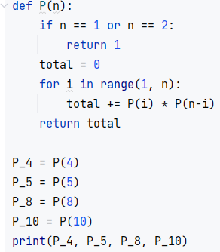

Matrix-chain Multiplication …contd
Example: consider the chain A₁, A₂, A₃, A₄ of 4 (i.e. n) matrices
Let us compute the product A₁A₂A₃A₄
There are 5 possible ways:
(A₁(A₂(A₃A₄)))
(A₁((A₂A₃)A₄))
((A₁A₂)(A₃A₄))
((A₁(A₂A₃))A₄)
(((A₁A₂)A₃)A₄)

Slide 6
Matrix-chain Multiplication …contd
To compute the number of scalar multiplications necessary, we must know:
Algorithm to multiply two matrices
Matrix dimensions
Algorithm to multiply two matrices?

Slide 7
Algorithm to Multiply 2 Matrices
Input: Matrices A_{p×q} and B_{q×r} (with dimensions p×q and q×r)
Result: Matrix C_{p×r} resulting from the product A·B
MATRIX-MULTIPLY(A_{p×q} , B_{q×r})
1. for i ← 1 to p
2. for j ← 1 to r
3. C[i, j] ← 0
4. for k ← 1 to q
5. C[i, j] ← C[i, j] + A[i, k] · B[k, j]
6. return C
Scalar multiplication in line 5 dominates time to compute C
Number of scalar multiplications = pqr

Slide 8
Matrix-chain Multiplication …contd
Example: Consider three matrices A_{10×100}, B_{100×5}, and C_{5×50}
There are 2 ways to parenthesize
((AB)C) = D_{10×5} · C_{5×50}
AB ⇒ 10·100·5=5,000 scalar multiplications
DC ⇒ 10·5·50 =2,500 scalar multiplications
(A(BC)) = A_{10×100} · E_{100×50}
BC ⇒ 100·5·50=25,000 scalar multiplications
AE ⇒ 10·100·50 =50,000 scalar multiplications
Total: 7,500
Total: 75,000

Slide 9
Matrix-Chain Multiplication
Given a chain of matrices 〈A₁, A₂, …, A_{n}〉, where for i = 1, 2, …, n matrix A_{i} has dimensions p_{i-1}x p_{i}, fully parenthesize the product A₁ ⋅ A₂ ⋅⋅⋅ A_{n} in a way that minimizes the number of scalar multiplications.
A₁ ⋅ A₂ ⋅⋅⋅ A_{i} ⋅ A_{i+1} ⋅⋅⋅ A_{n}
p₀ x p₁ p₁ x p₂ p_{i-1} x p_{i} p_{i} x p_{i+1} p_{n-1} x p_{n}

Slide 10
2. A Recursive Solution
Consider the subproblem of parenthesizing A_{i…j} = A_{i} A_{i+1} ⋅⋅⋅ A_{j} for 1 ≤ i ≤ j ≤ n
= A_{i…k} A_{k+1…j} for i ≤ k < j
Assume that the optimal parenthesization splits the product A_{i} A_{i+1} ⋅⋅⋅ A_{j} at k (i ≤ k < j)
m[i, j] =
p_{i-1}p_{k}p_{j}
m[i, k]
m[k+1,j]
m[i, k] + m[k+1, j] + p_{i-1}p_{k}p_{j}
min # of multiplications
to compute A_{i…k}
min # of multiplications
to compute A_{k+1…j}
# of multiplications
to compute A_{i…k}A_{k…j}

Slide 11
3. Computing the Optimal Costs
0 if i = j
m[i, j] = min {m[i, k] + m[k+1, j] + p_{i-1}p_{k}p_{j}} if i < j
^{i≤k<j}
Length = 1: i = j, i = 1, 2, …, n
Length = 2: j = i + 1, i = 1, 2, …, n-1
second
first
1
2
3
n
n
m[1, n] gives the optimal
solution to the problem
j
Compute rows from bottom to top and from left to right
In a similar matrix s we keep the optimal values of k
3
2
1
i

Slide 12
Multiply 4 Matrices: A×B×C×D (1)
Compute the costs in the bottom-up manner
First we consider AB, BC, CD
No need to consider AC or BD
ABCD
A(BCD)
(AB)(CD)
(ABC)D
ABC
BCD
A(BC)
(AB)C
B(CD)
(BC)D
AB
BC
CD
A
B
C
D

Slide 13
Multiply 4 Matrices: A×B×C×D (2)
Compute the costs in the bottom-up manner
Then we consider A(BC), (AB)C, B(CD), (BC)D
No need to consider (AB)D, A(CD)
ABCD
A(BCD)
(AB)(CD)
(ABC)D
ABC
BCD
A(BC)
(AB)C
B(CD)
(BC)D
AB
BC
CD
A
B
C
D

Slide 14
Multiply 4 Matrices: A×B×C×D (3)
Compute the costs in the bottom-up manner
Select minimum cost matrix calculations of ABC & BCD
ABCD
A(BCD)
(AB)(CD)
(ABC)D
ABC
BCD
min
min
A(BC)
(AB)C
B(CD)
(BC)D
AB
BC
CD
A
B
C
D

Slide 15
Multiply 4 Matrices: A×B×C×D (4)
Compute the costs in the bottom-up manner
We now consider A(BCD), (AB)(CD), (ABC)D
ABCD
A(BCD)
(AB)(CD)
(ABC)D
ABC
BCD
A(BC)
(AB)C
B(CD)
(BC)D
AB
BC
CD
A
B
C
D

Slide 16
Multiply 4 Matrices: A×B×C×D (5)
Compute the costs in the bottom-up manner
Finally choose the cheapest cost plan for matrix calculations
ABCD
min
A(BCD)
(AB)(CD)
(ABC)D
ABC
BCD
A(BC)
(AB)C
B(CD)
(BC)D
AB
BC
CD
A
B
C
D

Slide 17
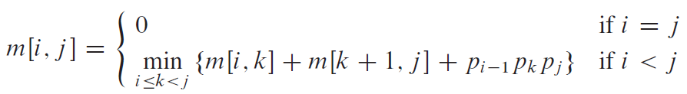
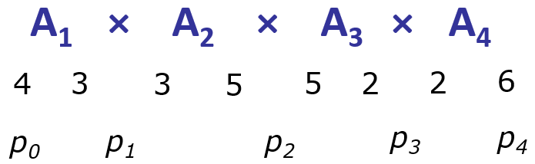
1
2
3
4
1
2
3
4
1
0
1
2
0
2
3
0
3
4
0
4
m(i,j), i ≤ j
k(i,j), i ≤ j

Slide 18
1
2
3
4
1
2
3
4
1
0
60
1
1
2
0
30
2
2
3
0
60
3
3
4
0
4
m(i,j), i ≤ j
k(i,j), i ≤ j

Slide 19
1
2
3
4
1
2
3
4
1
0
60
54
1
1
1
2
0
30
2
2
3
0
60
3
3
4
0
4
m(i,j), i ≤ j
k(i,j), i ≤ j

Slide 20
1
2
3
4
1
2
3
4
1
0
60
54
1
1
1
2
0
30
66
2
2
3
3
0
60
3
3
4
0
4
m(i,j), i ≤ j
k(i,j), i ≤ j

Slide 21
1
2
3
4
1
2
3
4
1
0
60
54
102
1
1
1
3
2
0
30
66
2
2
3
3
0
60
3
3
4
0
4
m(i,j), i ≤ j
k(i,j), i ≤ j

Slide 22
1
2
3
4
1
2
3
4
1
0
60
54
102
1
1
1
3
2
0
30
66
2
2
3
3
0
60
3
3
4
0
4
m(i,j), i ≤ j
k(i,j), i ≤ j

Slide 23
1
2
3
4
1
2
3
4
1
0
1
2
0
2
3
0
3
4
0
4
m(i,j), i ≤ j
k(i,j), i ≤ j

Slide 24
1
2
3
4
1
2
3
4
1
0
1
2
0
2
3
0
3
4
0
4
m(i,j), i ≤ j
k(i,j), i ≤ j

Slide 25
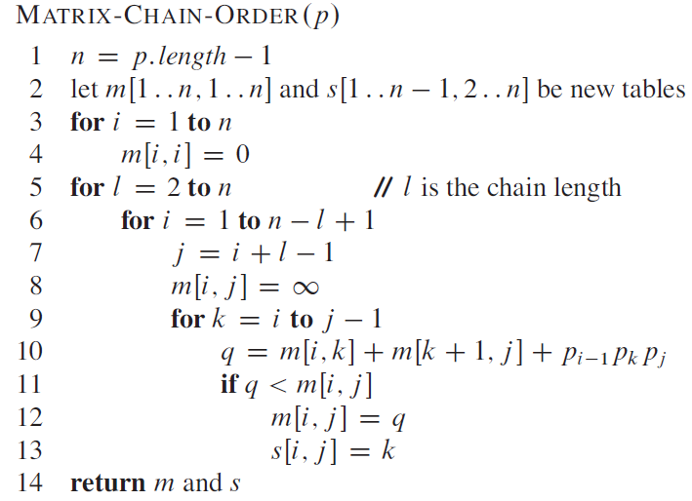
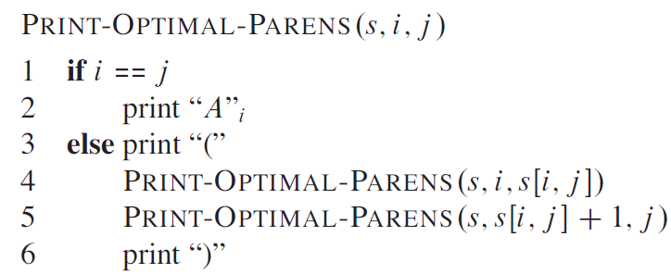

Slide 26
Memoization
Top-down approach with the efficiency of typical dynamic programming approach
Maintaining an entry in a table for the solution to each subproblem
memoize the inefficient recursive algorithm
When a subproblem is first encountered its solution is computed and stored in that table
Subsequent “calls” to the subproblem simply look up that value

Slide 27
Memoized Matrix-Chain
Alg.: MEMOIZED-MATRIX-CHAIN(p)
n ← length[p] – 1
for i ← 1 to n
do for j ← i to n
do m[i, j] ← ∞
return LOOKUP-CHAIN(p, 1, n)
Initialize the m table with
large values that indicate
whether the values of m[i, j]
have been computed
Top-down approach

Slide 28
Memoized Matrix-Chain
Alg.: LOOKUP-CHAIN(p, i, j)
if m[i, j] < ∞
then return m[i, j]
if i = j
then m[i, j] ← 0
else for k ← i to j – 1
do q ← LOOKUP-CHAIN(p, i, k) +
LOOKUP-CHAIN(p, k+1, j) + p_{i-1}p_{k}p_{j}
if q < m[i, j]
then m[i, j] ← q
return m[i, j]
Running time is O(n³)
m[i, j] = min {m[i, k] + m[k+1, j] + p_{i-1}p_{k}p_{j}} i≤k<j

Slide 29
Dynamic Progamming vs. Memoization
Advantages of dynamic programming vs. memoized algorithms
No overhead for recursion, less overhead for maintaining the table
The regular pattern of table accesses may be used to reduce time or space requirements
Advantages of memoized algorithms vs. dynamic programming
Some subproblems do not need to be solved

